Slide 1


ONLINE AUCTION SYSTEM
K.RAMAKRISHNAN COLLEGE OF TECHNOLOGY
ANJALI A (2403811720522006)
ASHWINI R (2403811720522007)
CHERMA SELVI A (2403811720522009)
DEEPANETHRA A (2403811720522011)
GUIDED BY
A.MALARMANNAN M.E

Slide 2
Problem Definition
Requires physical presence, making the process time-consuming and inconvenient
Limited reach, as only local participants can join
Manual management can lead to errors in recording bids and handling participants
Difficult to track bidder information and maintain records
Managing multiple auctions simultaneously is challenging
Solution: Online Auction Management System

Slide 3
Objectives of the Project
Provide a platform for buying and selling items through online bidding
Allow users to easily register and participate
Real-time bid updates for transparency
Saves time and improves efficiency
Supports multiple auctions at once
Create a reliable, fast, and secure auction systems

Slide 4
System Requirements
Hardware Requirements
Processor: Intel i3 or higher
RAM: Minimum 4 GB
Storage: 500 GB HDD/SSD
Network: Internet connection

Slide 5
System Requirements
Software Requirements
OS: Windows / Linux
Backend: PHP
Frontend: HTML, CSS
Database: MySQL
Tool: XAMPP
Browser: Chrome / Firefox / Edge
Editor: VS Code

Slide 6
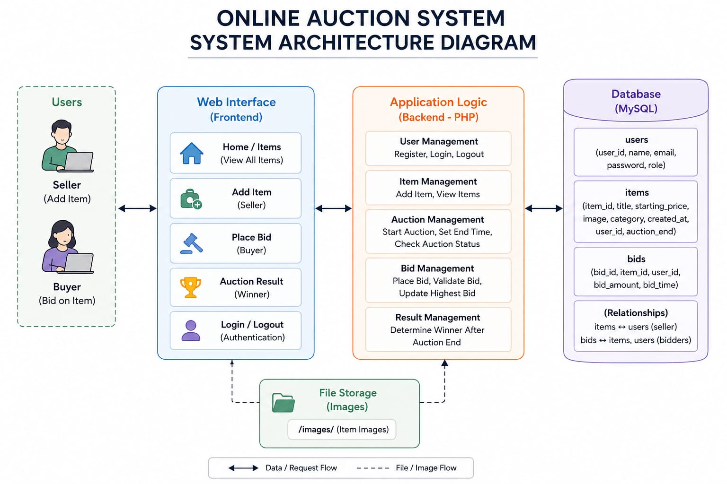
System Architecture

Slide 7
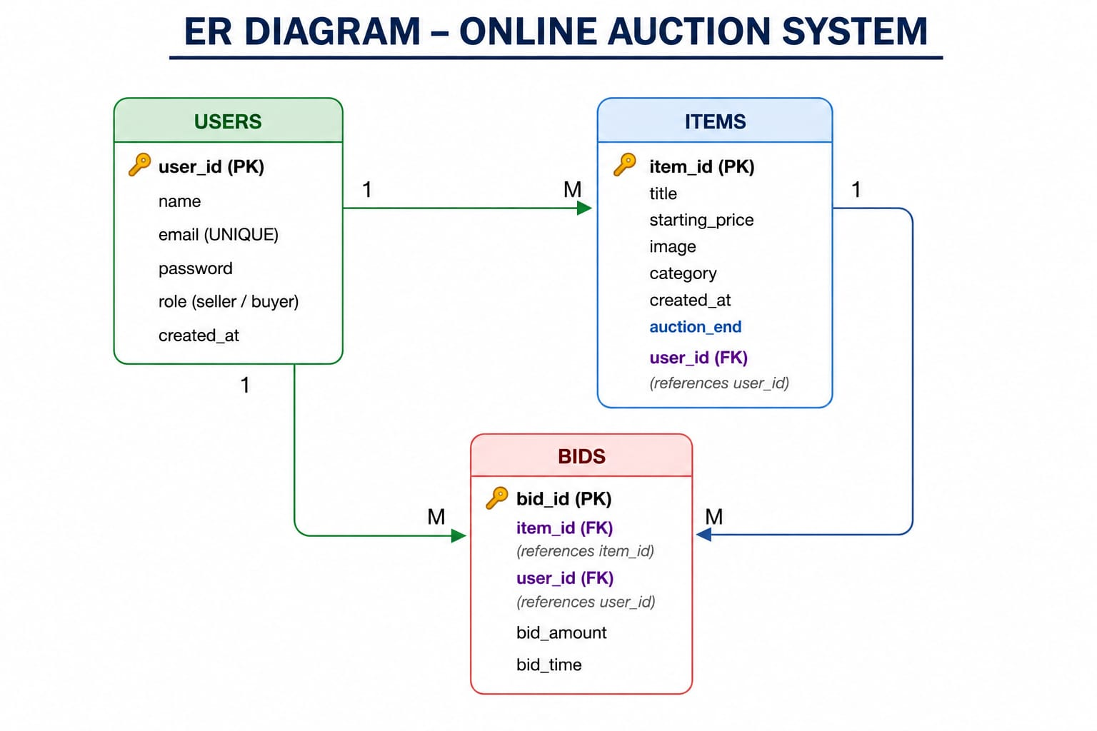
ER Diagram

Slide 8
Relational Schema
User(User_ID, Name, Email, Password, Created_At)
Items(Item_ID,Title, Starting_Price, Category, Image, Created_At, Auction_End, User_ID)
Bids(Bid_ID, Item_ID, User_ID, Bid_Amount, Bid_Time)

Slide 9
Normalization
1NF: Remove repeating groups
2NF: Remove partial dependency
3NF: Remove transitive dependency
Benefits:
No data redundancy
Better consistency
Proper relationships

Slide 10
Database and Table Creation
CREATE DATABASE auction_db;
USE auction_db;
CREATE TABLE users (
user_id INT AUTO_INCREMENT PRIMARY KEY,
name VARCHAR(100),
email VARCHAR(100) UNIQUE,
password VARCHAR(255),
role VARCHAR(20),
created_at DATETIME DEFAULT CURRENT_TIMESTAMP
);

Slide 11
Database and Table Creation
CREATE TABLE items (
item_id INT AUTO_INCREMENT PRIMARY KEY,
title VARCHAR(100),
starting_price INT,
image VARCHAR(255),
category VARCHAR(50),
created_at DATETIME DEFAULT CURRENT_TIMESTAMP,
auction_end DATETIME,
user_id INT,
FOREIGN KEY (user_id) REFERENCES users(user_id)
);

Slide 12
Database and Table Creation
CREATE TABLE bids (
bid_id INT AUTO_INCREMENT PRIMARY KEY,
item_id INT,
user_id INT,
bid_amount INT,
bid_time DATETIME DEFAULT CURRENT_TIMESTAMP,
FOREIGN KEY (item_id) REFERENCES items(item_id),
FOREIGN KEY (user_id) REFERENCES users(user_id)
);

Slide 13
SQL Implementation & Queries
INSERT :
INSERT INTO users(name,email,password,role)
VALUES('Arun','arun@gmail.com','123456','buyer’);
INSERT INTO items(title,starting_price,image,category,auction_end,user_id)
VALUES('Laptop',30000,'laptop.jpg','Electronics',
DATE_ADD(NOW(), INTERVAL 1 DAY),1);
SELECT :
SELECT * FROM items;

Slide 14
SQL Implementation & Queries
UPDATE :
UPDATE items
SET starting_price = 32000
WHERE item_id = 1;
DELETE :
DELETE FROM items
WHERE item_id = 1;

Slide 15
Modules 1
USER MODULE
User registration (name, email, password)
Secure login using credentials
Session management (login/logout)
View profile details
Role-based access (Buyer / Seller / Admin)
Password

Slide 16
Modules 2
BUYER MODULE
Browse all available items
View item details (price, category, image, time)
Check highest bid
Place bids on items
View auction status (Running / Ended)
See winner after auction ends

Slide 17
Module 3
BIDDING MODULE
Allows users to place bids
Validates bid amount:
Greater than starting price
Greater than current highest bid
Stores bid details (user_id, item_id, amount, time)
Retrieves highest bid using MAX()
Maintains bid history
Prevents invalid bids

Slide 18
Module 4
ADMIN MODULE
Admin login access
View all users, items, and bids
Delete inappropriate items or users
Monitor system activities
Manage categories (optional)
Ensure system security and integrity
Generate reports (optional)

Slide 19
Challenges Faced
Difficulty in handling and maintaining large amounts of user, item, and bid data accurately
Difficulty in coordinating between User, Seller, Buyer, and Admin modules
Hard to monitor auction status and manage real-time bidding updates

Slide 20
Conclusion
The Online Auction System was successfully developed to provide a platform for buying and selling items through bidding. It ensures efficient data management, secure user interaction, and accurate bidding processes. Despite some challenges in real-time tracking and integration, the system achieves its objective of conducting auctions in a simple and effective manner.

